Slide 1
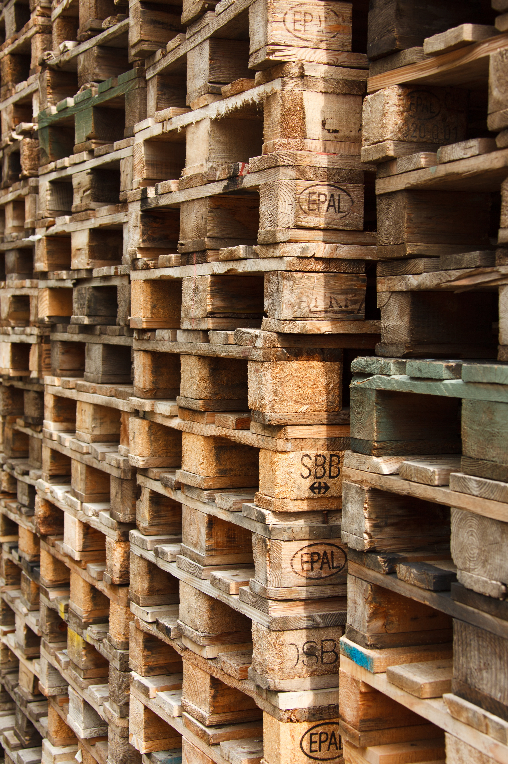
product product​ project 03 Shipment summary summary summary
GROUP 02
Josh Martin
Archana
Udeshi Pereira

Slide 2
agenda
a
Project overview​
Design process​
Technologies used
Demo​
What do we do?
Gathering the data
Visualisation drafted
Data workflow
Jupiter notebook
PGadmin
SQLalchamy
HTML
CSS
Javascript
Final visualization on the website
Demonstrating the analysis with the demo website

Slide 3

project
overview

Slide 4
Motivation
We wanted to keep the data specific to the industries that we are familiar with.
We have decided to use data from a company that one of us is currently employed (With permission).
Use real data, to generate useful and meaningful visuals that can be used in real world situations.

Slide 5

What do we do?
The data set we are using for this project contains the delivery information for a manufacturing company.
We are attempting to identify if there are any trends with product type and its delivery.
The data has multiple sites and is across a financial year.
We are hoping we may be able to find seasonal trends and/or areas that are high users of certain products.

Slide 6
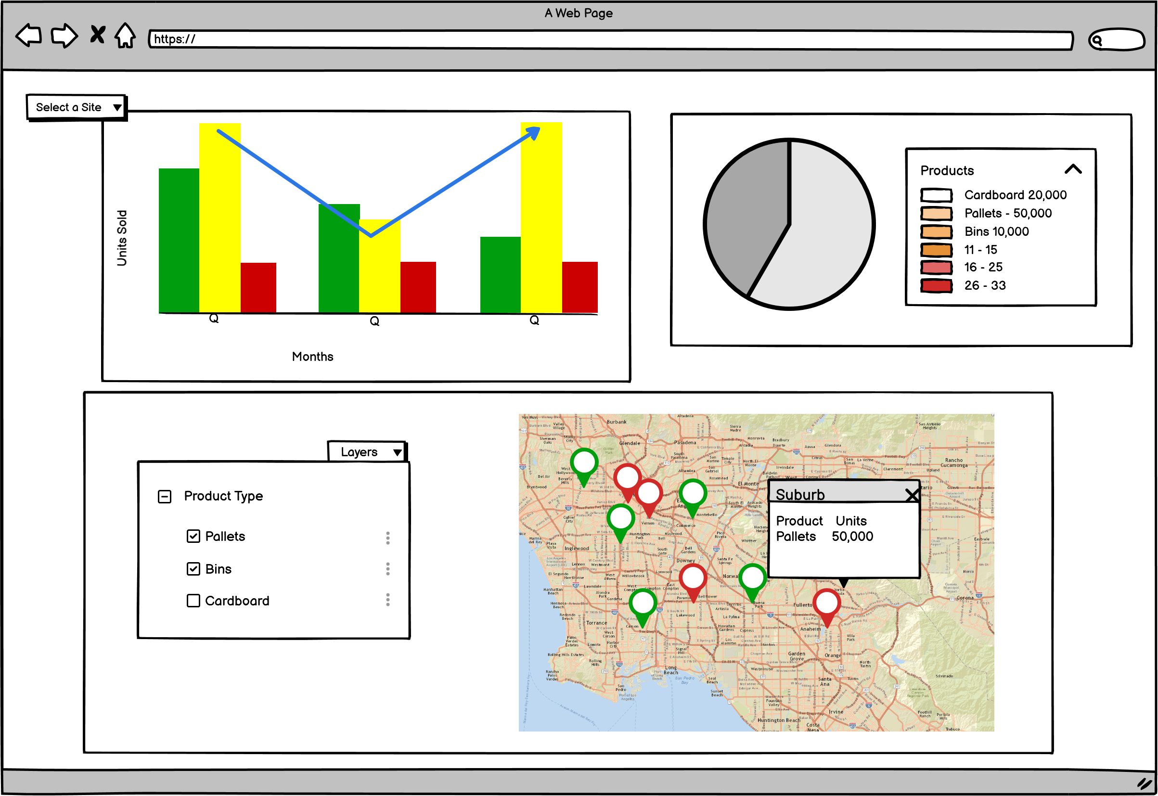

Slide 7

Design process
We are extracting the data from the .csv file using the pandas library and also transforming the data using the pandas library.
Then using pyalchemy we are loading the data into our relational SQL database PostgreSQL.
We will be connecting our database to our front end using ds.js, Leaflet and Anime.js libraries to create our visualisations within our Html file

Slide 8
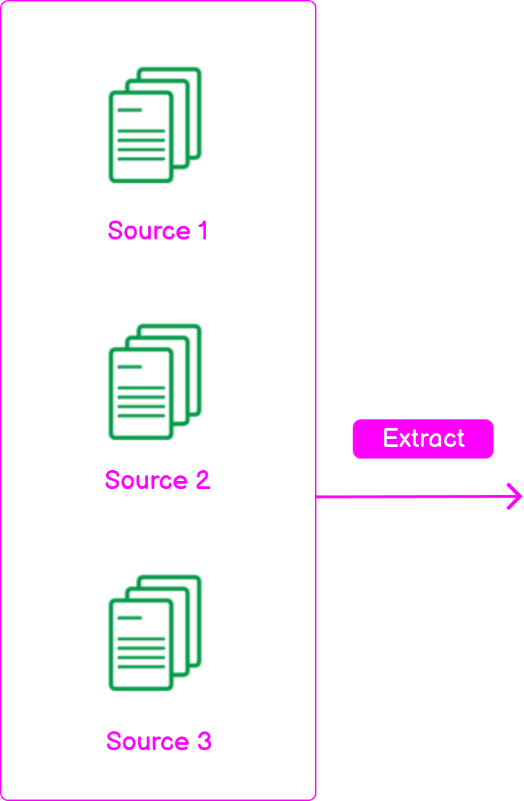
Data Pipeline

Slide 9

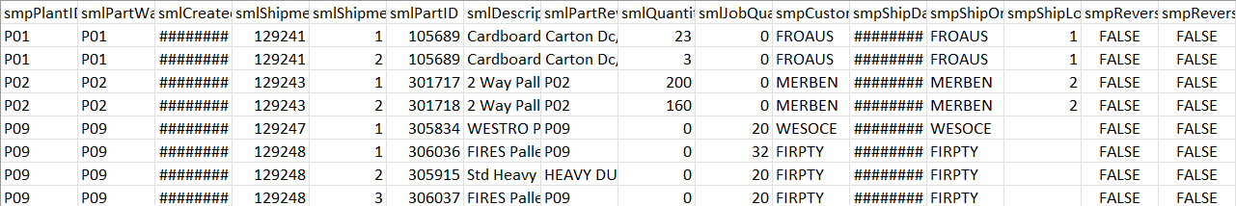
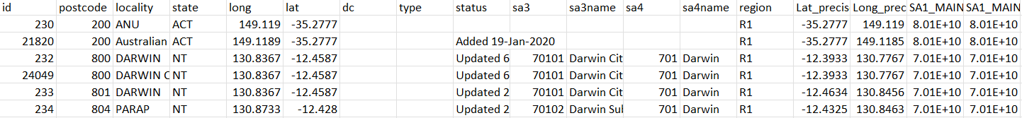
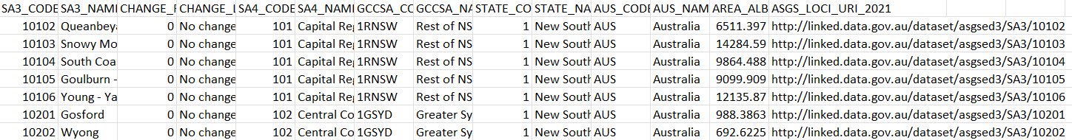
Raw Data
Shipment data csv
Postcode data csv
SA3 data csv

Slide 10
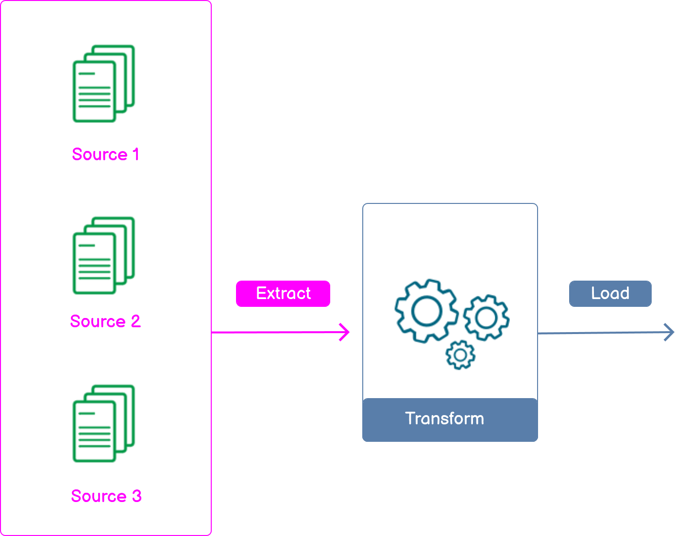
Data Pipeline

Slide 11

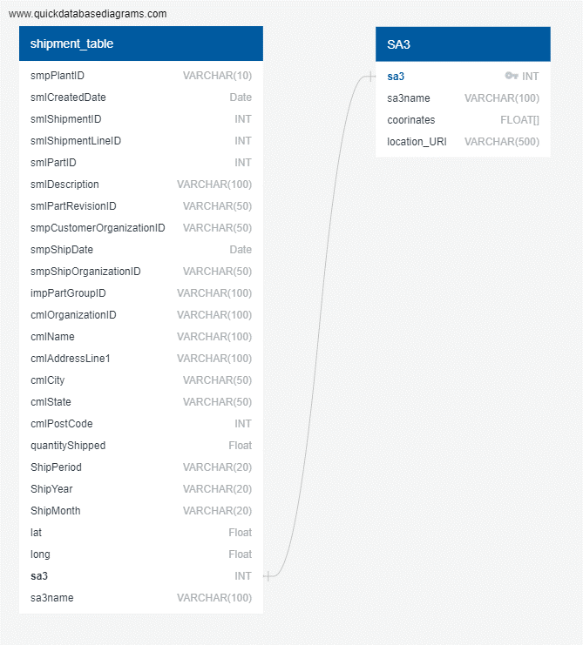
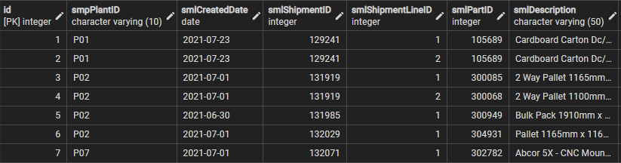
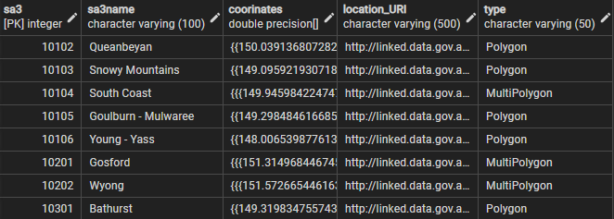
PGAdmin
ERD Design
Shipment table
SA3 table

Slide 12
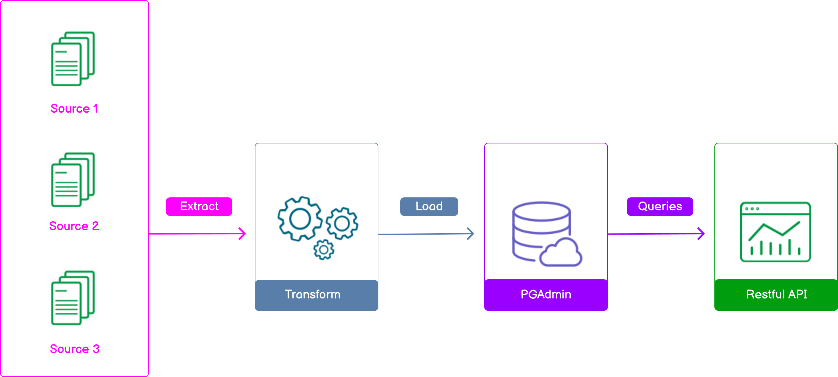
Data Pipeline

Slide 13
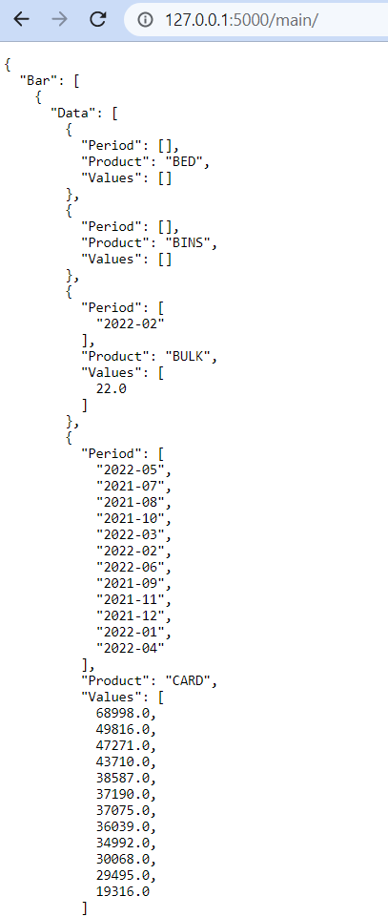
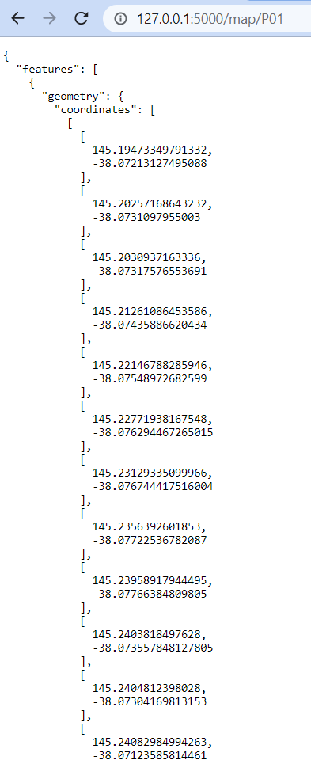
API Endpoints
/main
/map/<siteid>

Slide 14
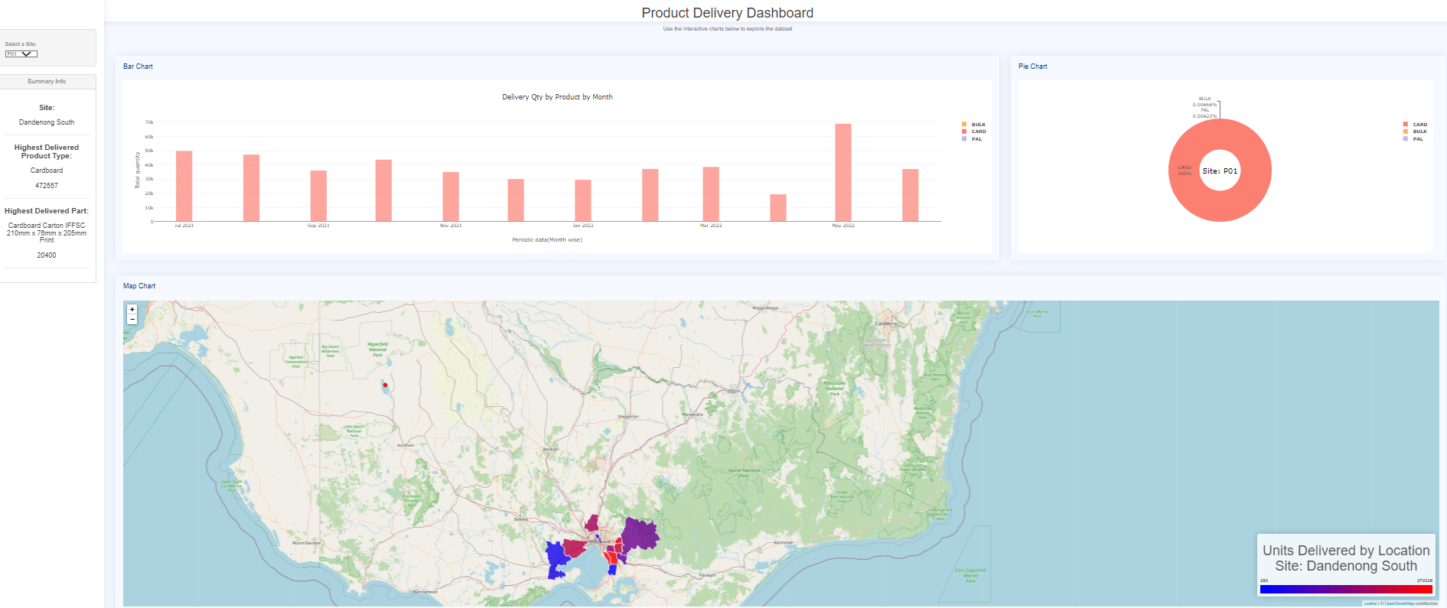
visualization

Slide 15

Analysis
Summary
Bar Chart
Pie Chart
Maps

Slide 16
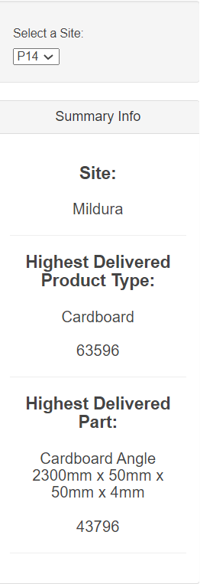
Summary information
For a selected site from the list, this Summary info label will display the Highest Delivered Product type and Highest Delivered Part. Also we used anime.js to display the data
Summary for site P14

Slide 17
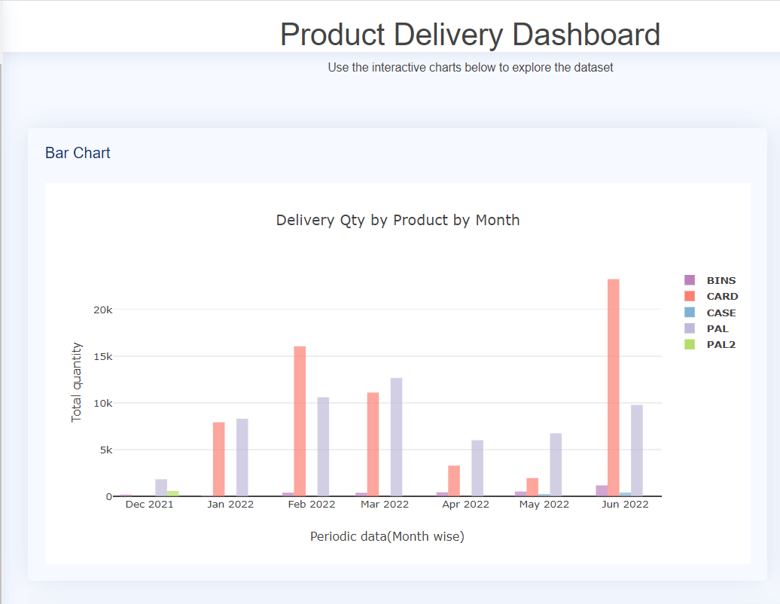
Bar chart
For a selected site from the list, bar chart is used to analyse the data for a particular site across a certain period of time.
For instance you can understand that the total sales are low during the December period. This may be due to business closures during the holidays.
June- There is a increase in the total number of sales over the past few months. This may be to use the budget allocation for the current financial year etc.
Bar chart for site P14

Slide 18
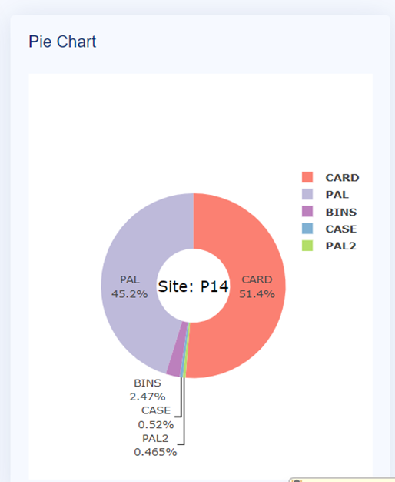
Pie chart
For a selected site from the list, pie chart is used to analyse the data for a particular site and the sales that happened for each different item over the total sales.
In this example here, Cardboard contributed to majority sales while PAL2 is the least popular item.
Pie chart for site P14

Slide 19
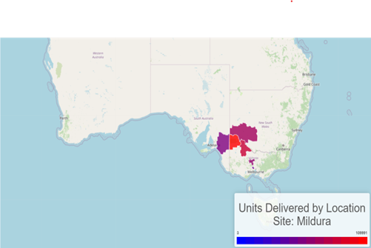
MAPS
For a selected site from the list, Maps are used to analyse the data for a particular site and the distribution of products across different geographical locations
In this example here, from Mildura the more number of units are delivered to this area shown in RED from the colour scale shown BLUE being LOW and RED being HIGH.
Map for site P14

Slide 20
Thank
thank
Thank
You
You
You
you
Thank you Listening to us. You can view our project live page Here.

